Slide 1
Sprint2 Demo - Water pump status detection -
Team Hamburg
Tetiana, Anandhu, Haruka
13 November, 2025

Slide 2

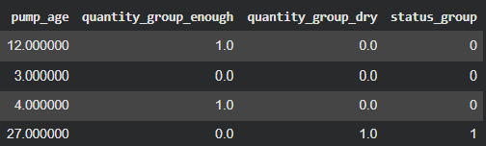
ML pipeline
Feature values
Target values
Construction_year
region
quantity_group
payment_type
extraction_type_class
management
quality_group
status_group
Raw data
Data cleaning
Replace zero value with mean of construction_year
pump_age = recorded_year – construction_year
Feature engineering
Label encoding
{"functional": 0,
"non functional": 1,
"functional needs repair": 2}
One hot encoding
Train model
Repeat
K times
(K-fold cross validation)
Predict pump status
Calculate accuracy

Slide 3
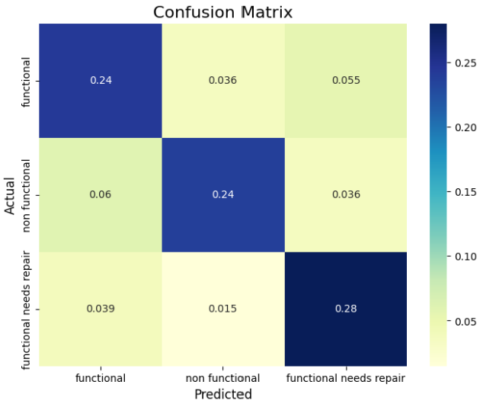
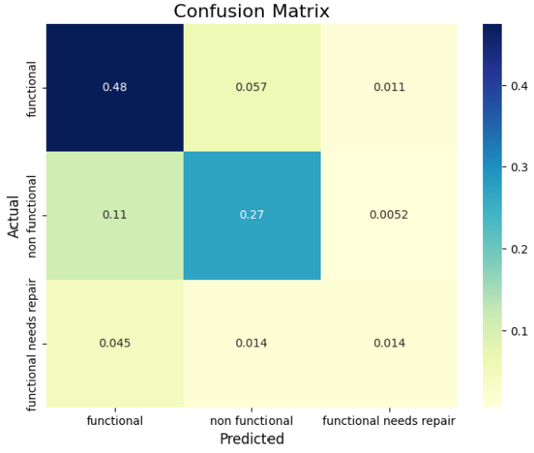
Class imbalance
SMOTE improved accuracy by 1% compared to simple oversampling and ADASYN
SMOTE, ADASYN: slower
+26% accuracy for minority class
Without oversampling
With oversampling
(Simple oversampling)

Slide 4
Model comparison
Experiment condition:
Without hyperparamter tuning
With basic oversamping
Model | Accuracy (aka classification rate in leaderboard)
Softmax regression (Multinominal logistic regression) (K=50) | 0.60 | Hyperparameter tuning could improve performance
Linear classifiers with SGD training (K=50) | 0.58 | Slowest SGD could need more iteration and hyperparameter tuning
Decision tree (K=40) | 0.75 | Fastest Depth = 41 -> can set maximum of depth for better interpretability, but could lead to worse performance

Slide 5
Summary
All models struggled with minority class prediction
-> Improved by oversampling
Simple oversampling would enough
Decision tree performed best (without tuning)
-> other models could perform better after tuning
What’s next?
Interpret classifiers
Try Random forest or neural network
Tune hyperparameter
Try with other features

